Slide 1
First year project 2025
How anisotropic distribution of protein can help organize wound healing
Valdemar Emil Krogh-Mayer tqm926@alumni.ku.dk
jpd45

Slide 2
F
Adip

Slide 3
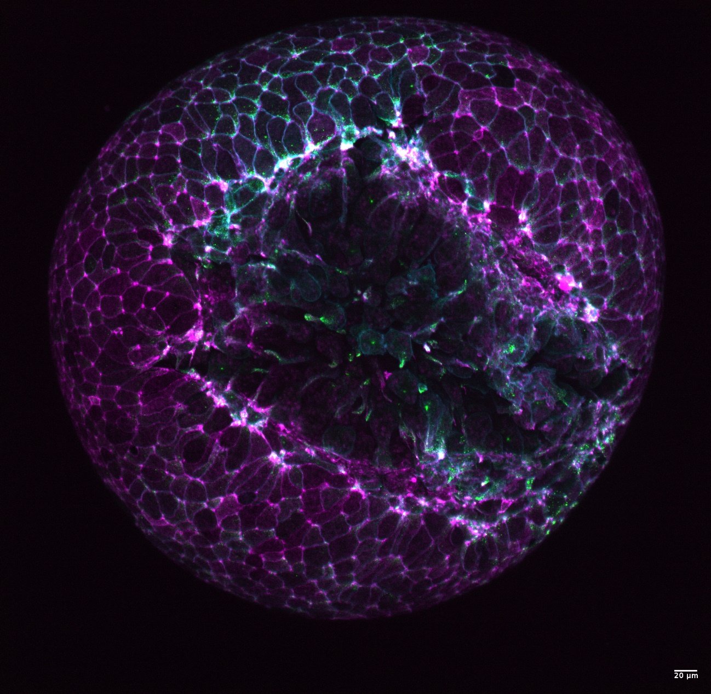

Slide 4
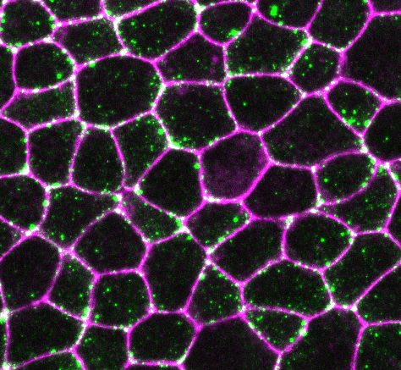

Slide 5
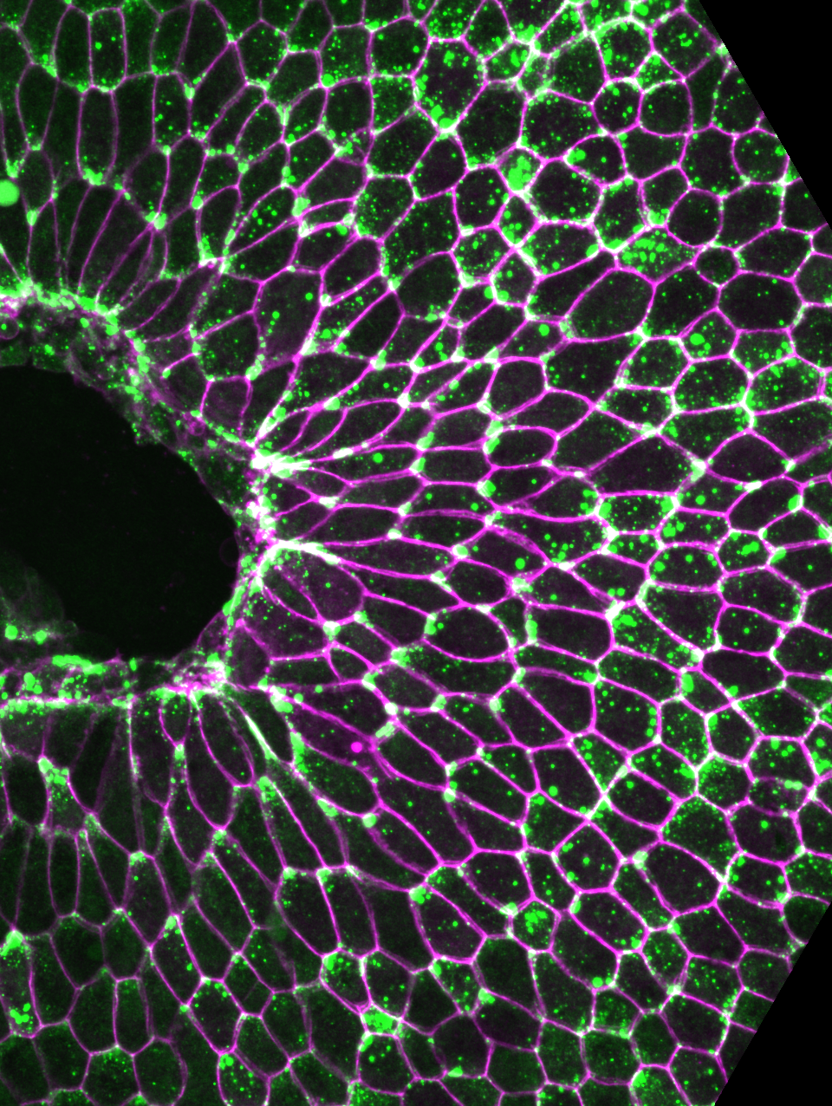

Slide 6
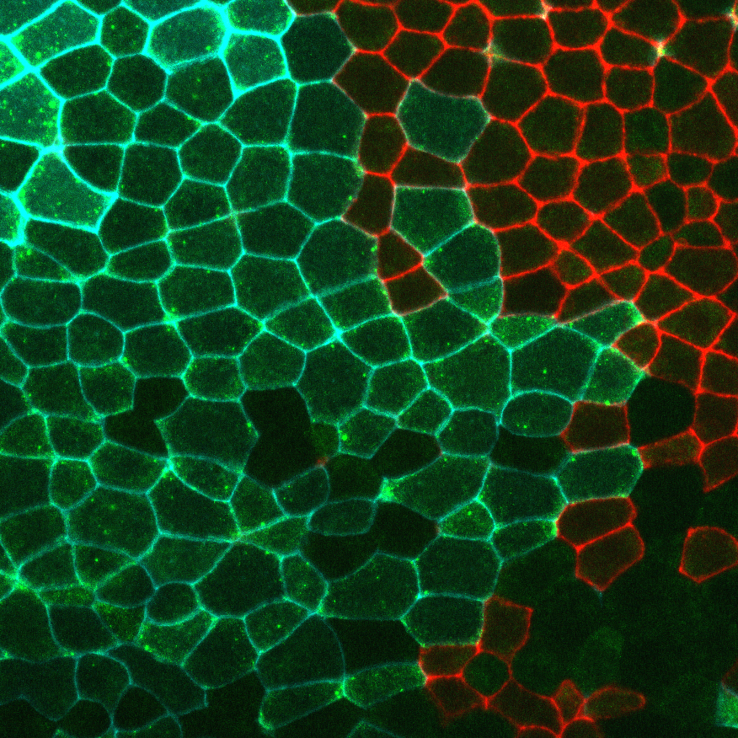

Slide 7
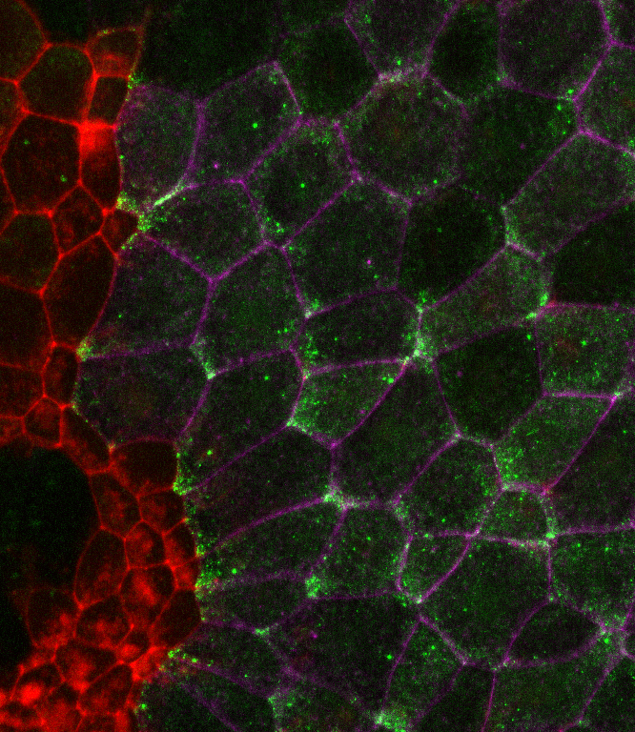

Slide 8
